Slide 1
History of Web Design
PDX DUG Front-end Meetup
March 2013

Slide 2
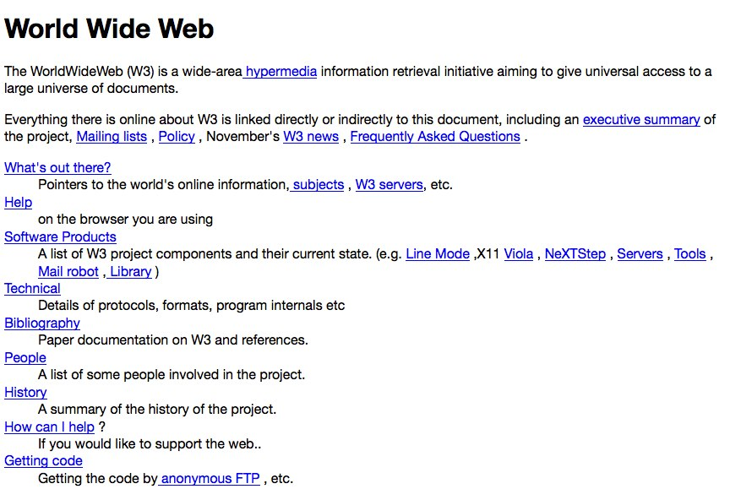

Slide 3
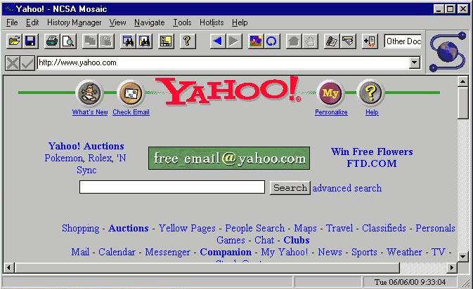

Slide 4
The 90s
Slow internet connections (compared to now)
Consideration for certain screen resolutions
640x480, 800x600, 1024x768
Narrow, crowded layouts
Web-safe colors
- 8bit, 24bit
- Strong, saturated colors
Web-safe fonts
Popular: Times New Roman, Arial, Courier New, Comic Sans
Table layouts
Spacer GIFs

Slide 5
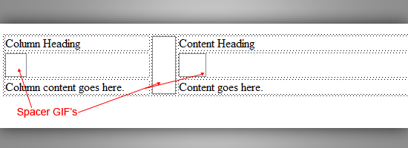

Slide 6
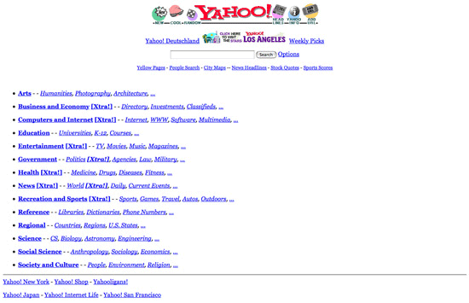

Slide 7
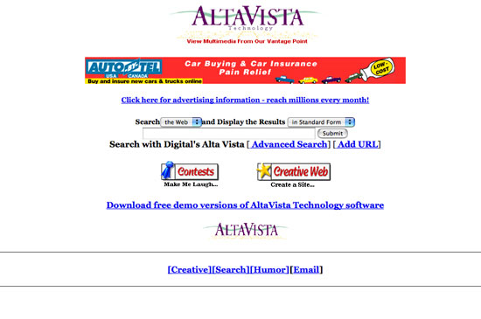

Slide 8
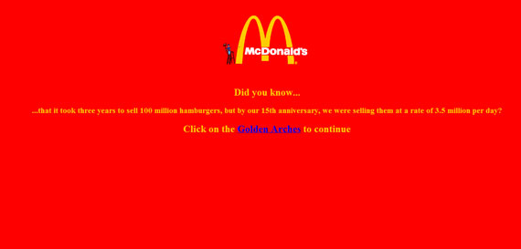

Slide 9
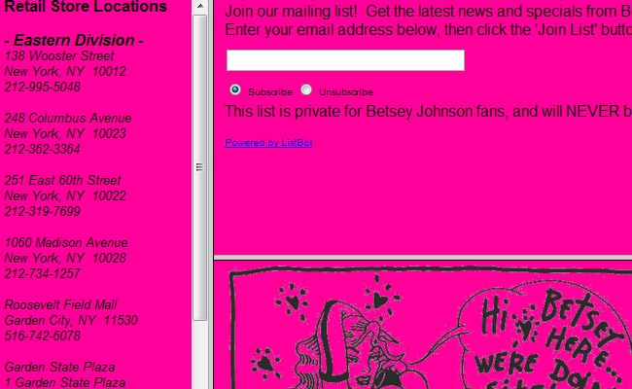

Slide 10
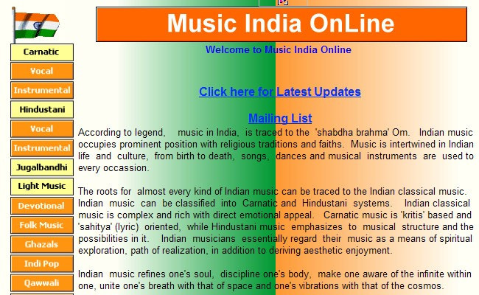

Slide 11
Flash introduced
Browser wars
- Not a lot of standardization
- Either target a specific browser or make super simple
Other common design elements
- Animated GIFs
- Graphics instead of text for words
- Banner images
- Crowding information

Slide 12
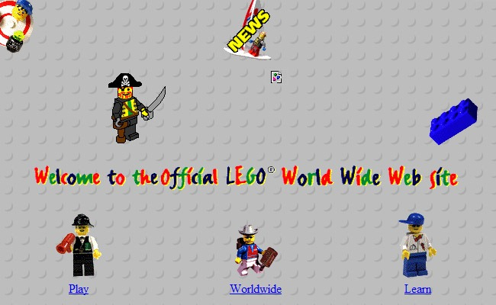

Slide 13
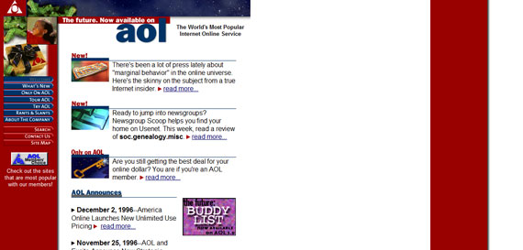

Slide 14
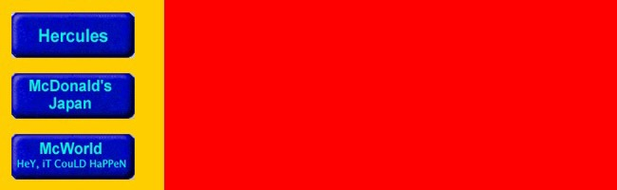

Slide 15


Slide 16
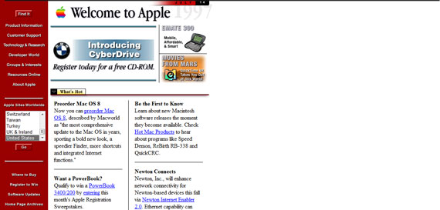

Slide 17
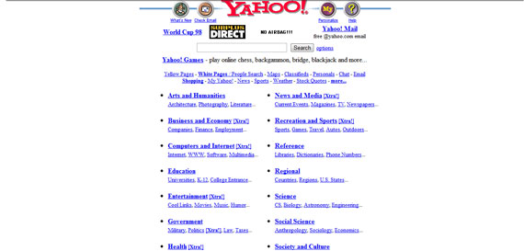

Slide 18
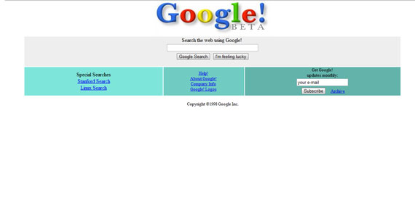

Slide 19
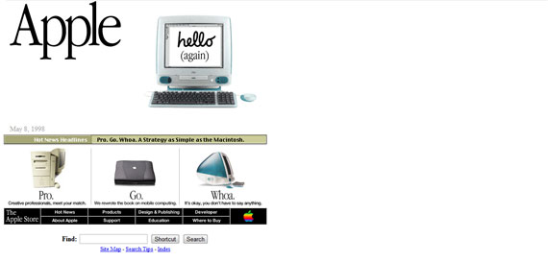

Slide 20
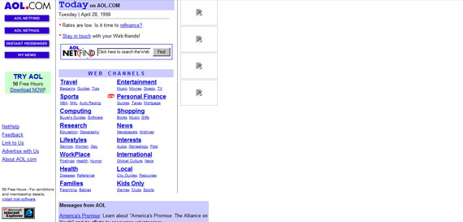

Slide 21
2000s
Faster internet connections
- More flash
- Media
Bigger monitors with better color capabilities
- More colors, better palettes
Greater attention to navigation structure and UI
- Usability started to become a focus
- Splash pages

Slide 22
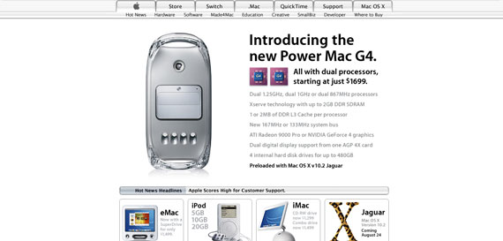

Slide 23
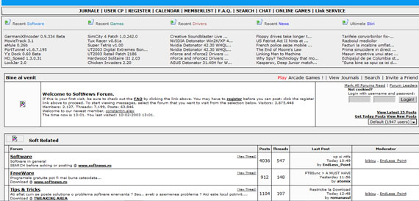

Slide 24
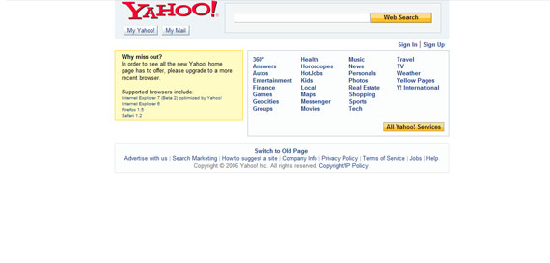

Slide 25
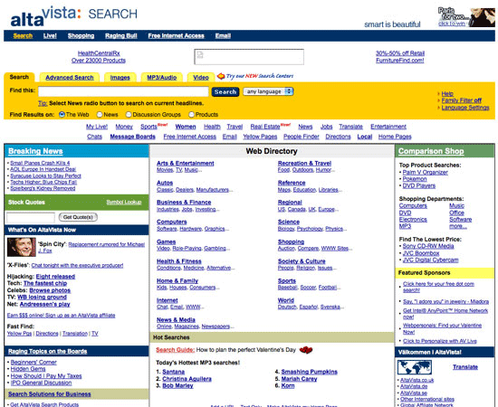

Slide 26
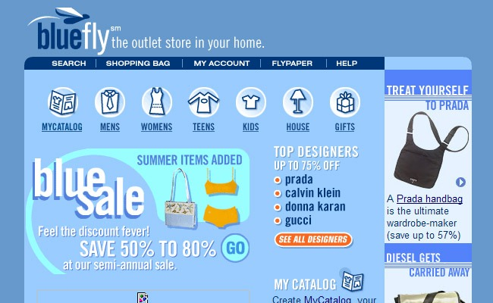

Slide 27
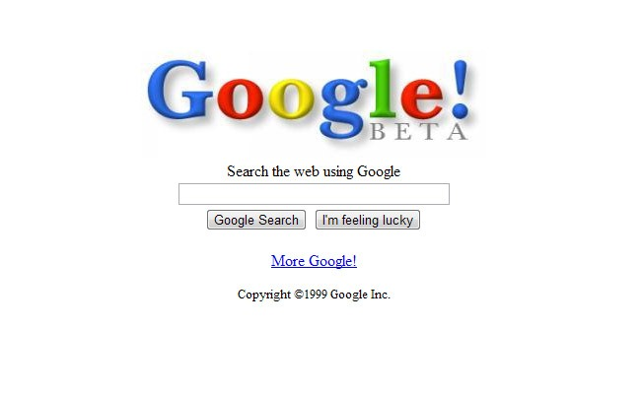

Slide 28
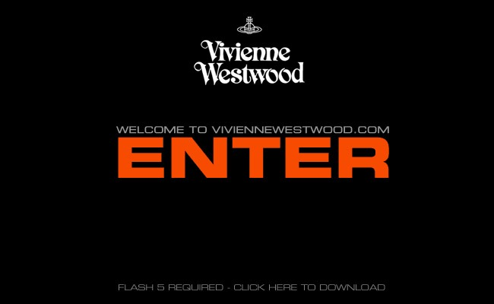

Slide 29
Separation of content and display
- Tables vs. CSS
- Increased browser support for CSS
- Zen Garden

Slide 30
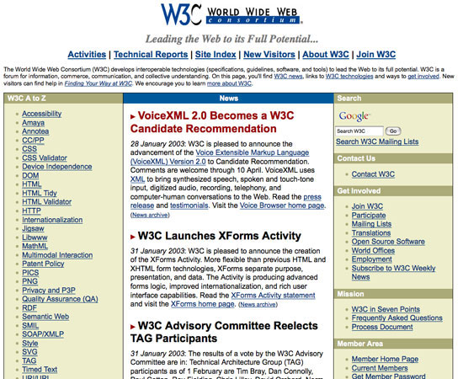

Slide 31
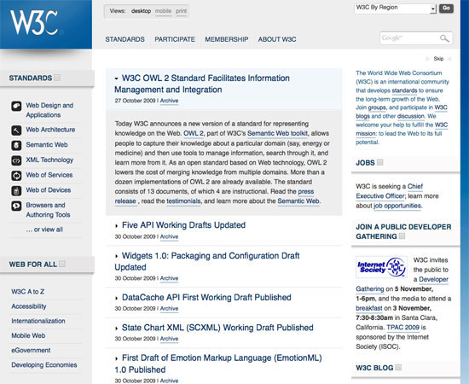

Slide 32
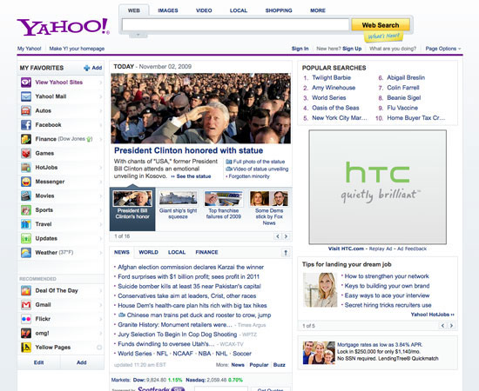

Slide 33
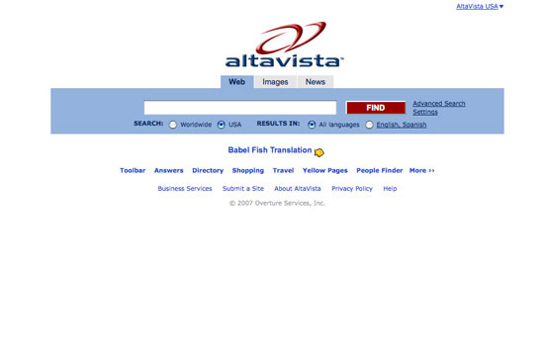

Slide 34
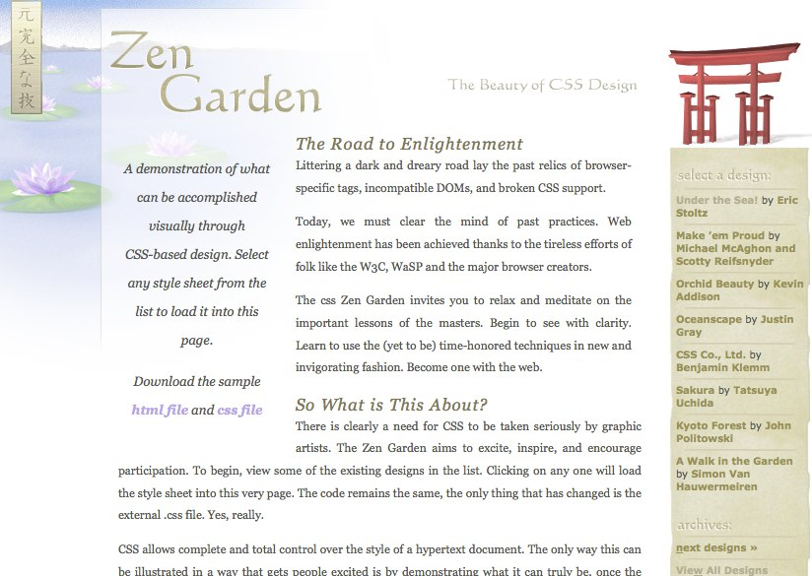

Slide 35
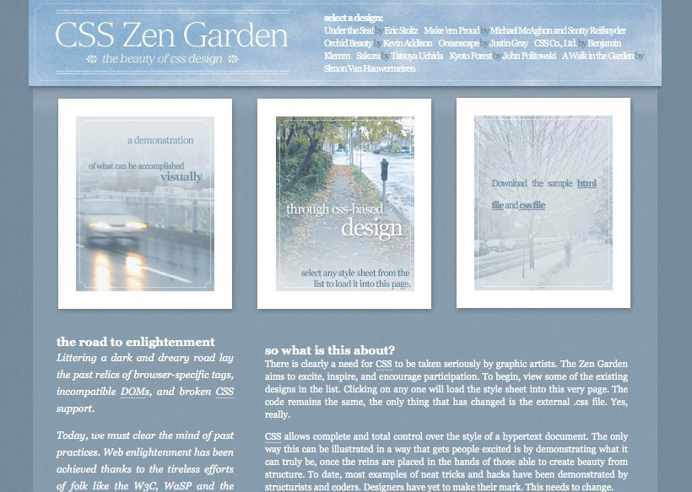

Slide 36
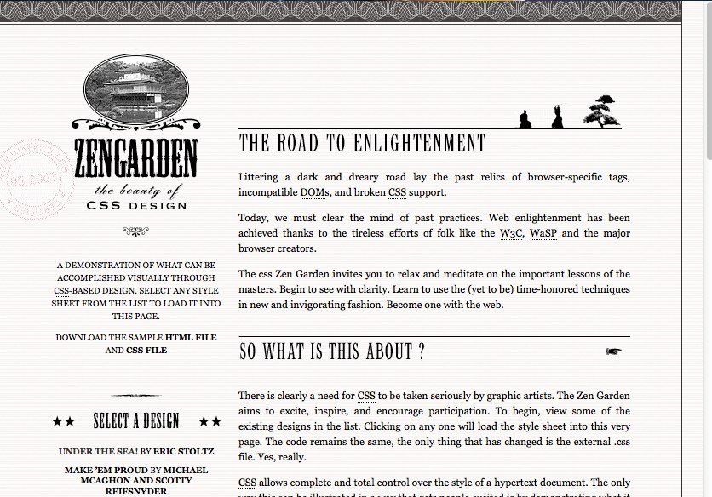

Slide 37
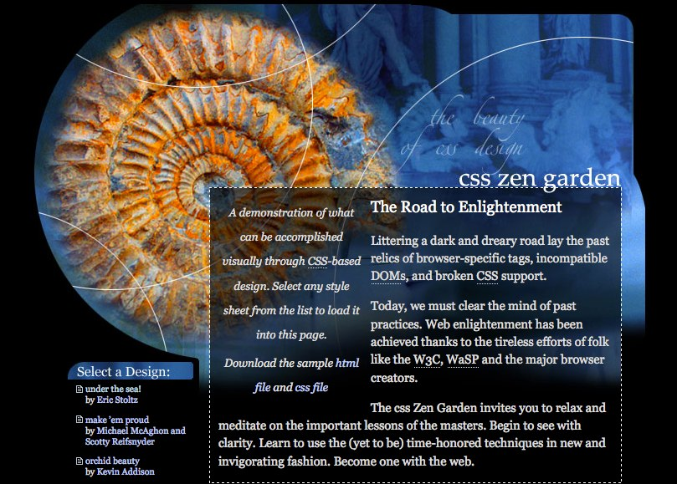

Slide 38
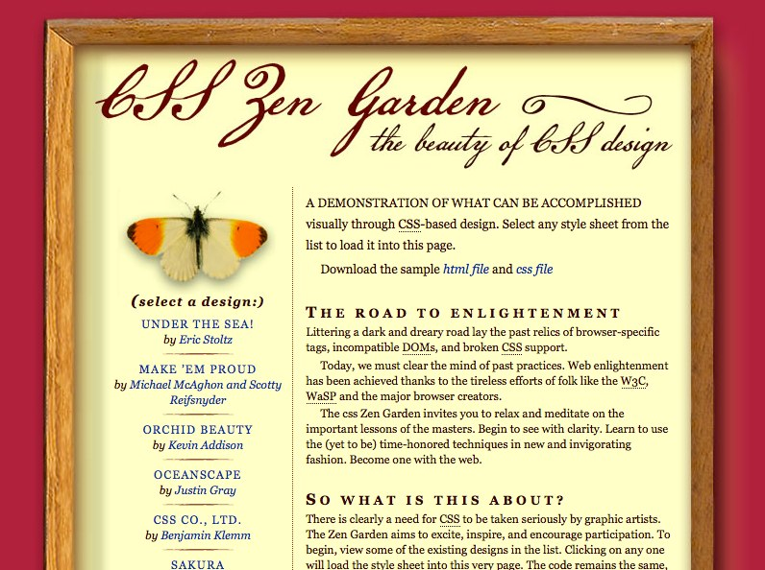

Slide 39
Web 2.0
- User-centered design
- Simplicity
- Lightweight
- Social
- "Flow”
- Interactive
- Starting to think in flexible terms
- Dynamic

Slide 40
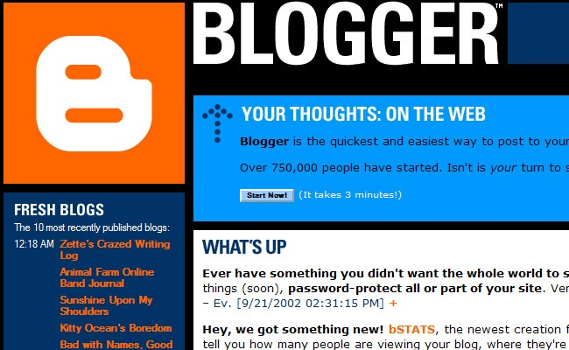

Slide 41
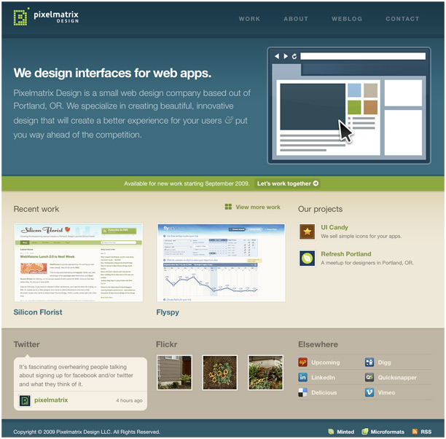

Slide 42
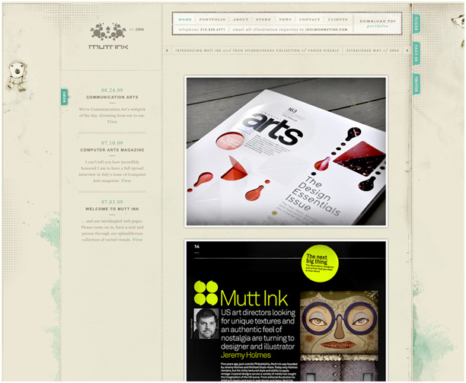

Slide 43
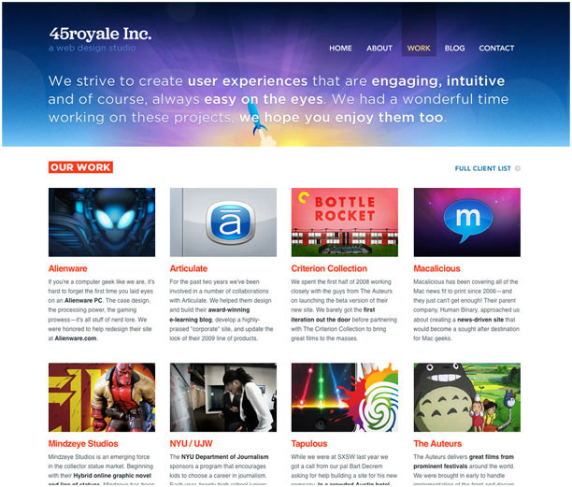

Slide 44
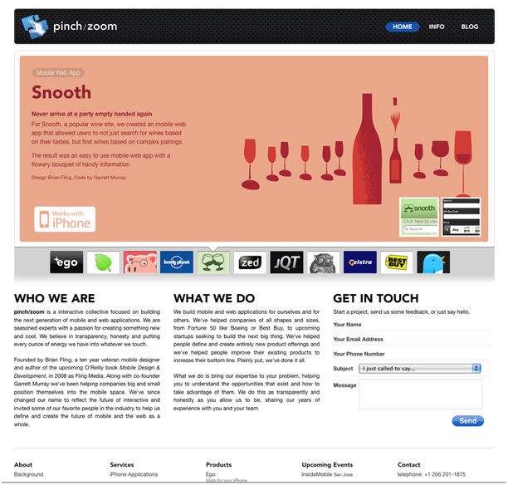

Slide 45
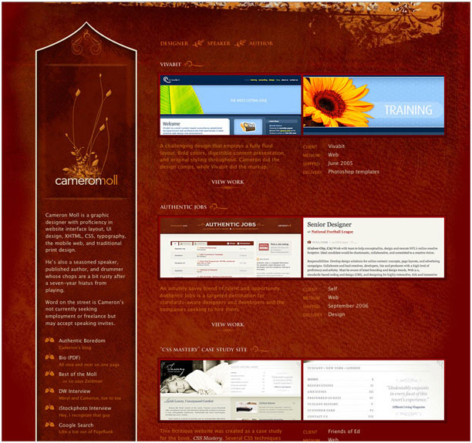

Slide 46
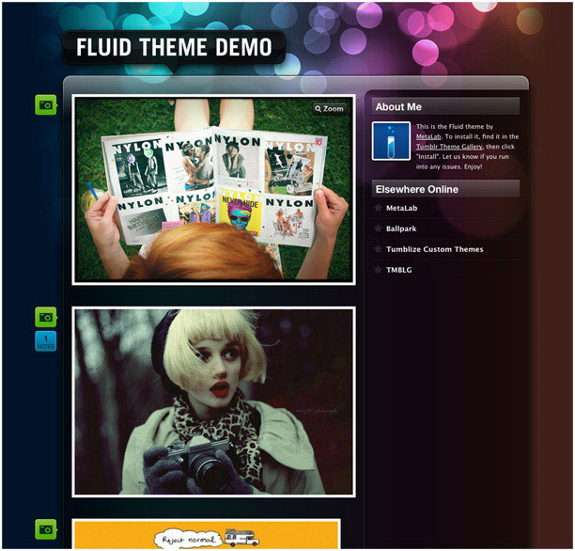

Slide 47
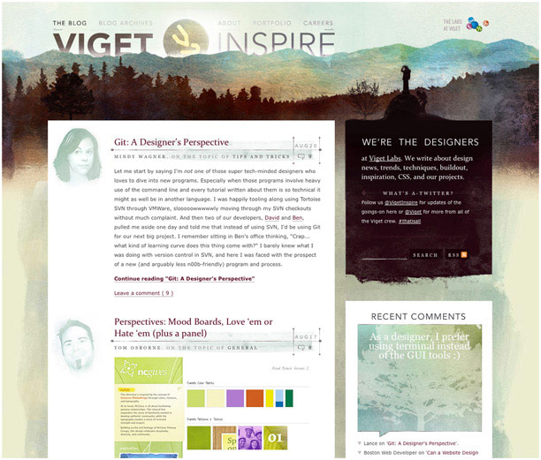

Slide 48
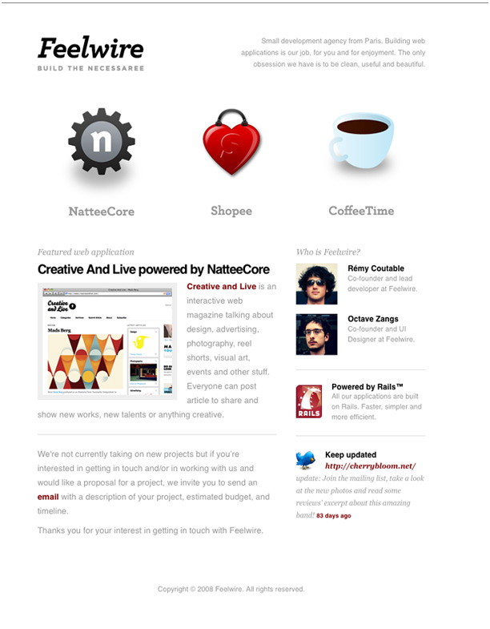

Slide 49
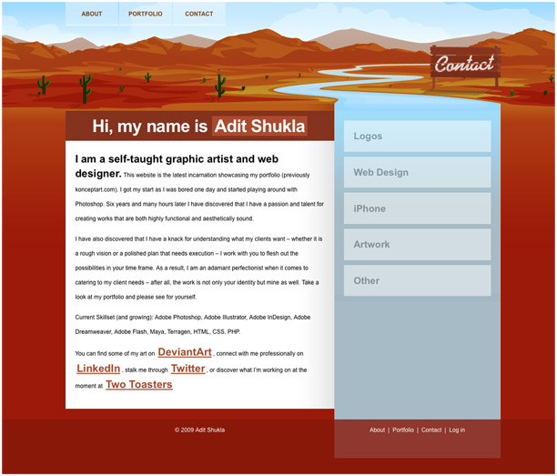

Slide 50
Web 2.0 Design trends
Textures
Larger images
Central layout
"Depth”
Fewer columns
Distinct header
White space
Bolder logos
- Bigger text- Icons

Slide 51
2010s
Mobile
Load times important again
Screen size important again
Other web-capable devices
Laptops / notebooks
Tablets
E-readers
TVs
Gaming stations
Printers
Cars / vehicles
Appliance
- Security systems

Slide 52
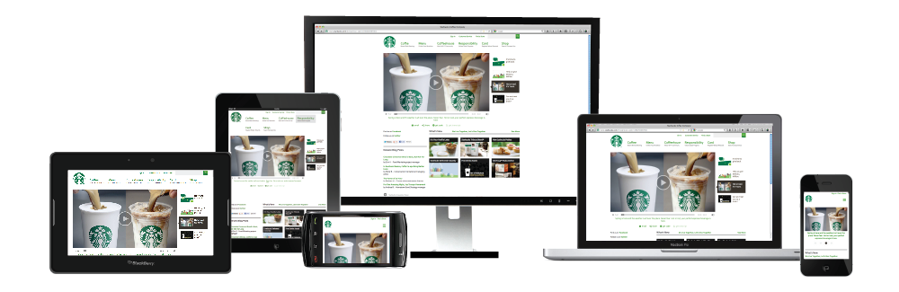

Slide 53
CSS3 gaining more browser support
Wide variety of font options
Font Squirrel
Image-esque capabilities with no images
Drop-shadows
Rounded corners
Text shadows (on most browsers)
Font icons
Gradients
Rotating

Slide 54
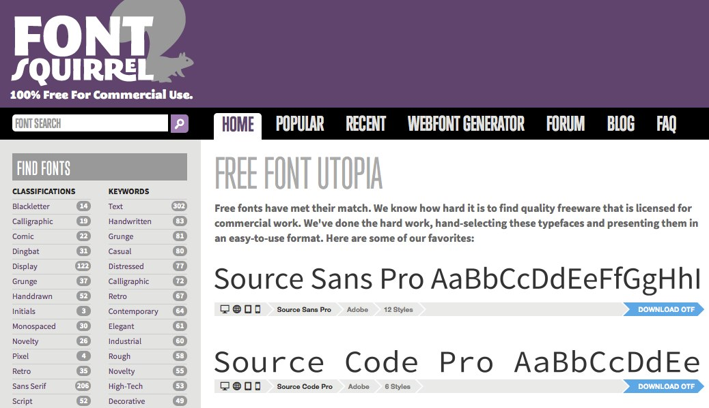

Slide 55
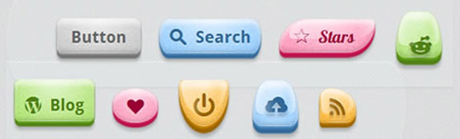

Slide 56
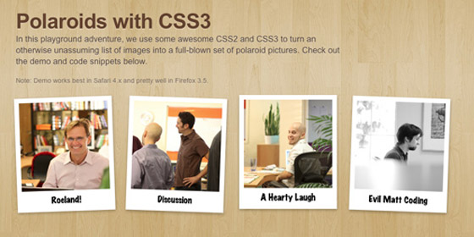

Slide 57
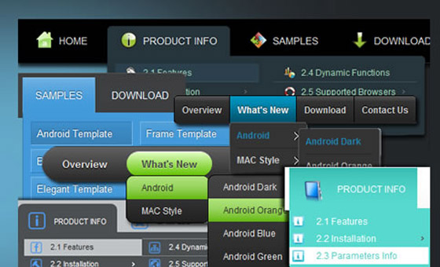

Slide 58
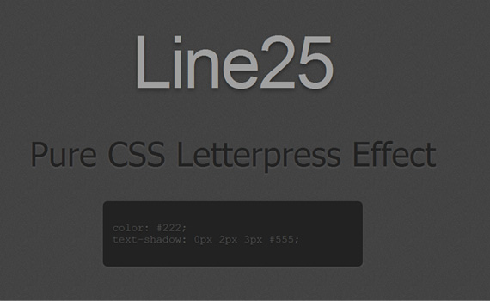

Slide 59


Slide 60


Slide 61
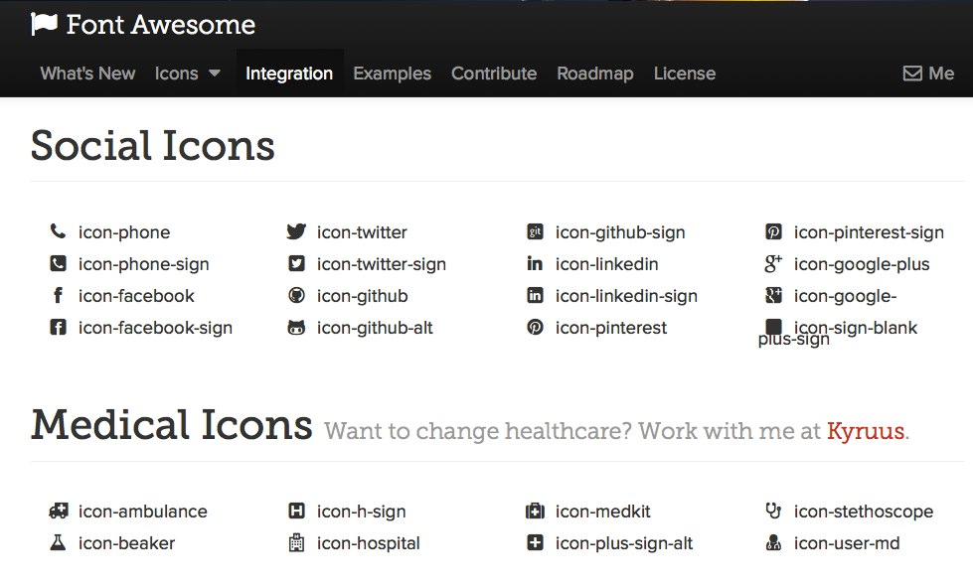

Slide 62
Responsive Web Design (RWD)
Adapting or responding the styling to a device's screen size
A flexible, grid-based layout
Move from absolute (pixel-based) measurements to relative ones
Flexible images and media
Media queries
Rearranging or restyling based on browser's width
Breakpoints
Mobile first / content first / user first

Slide 63
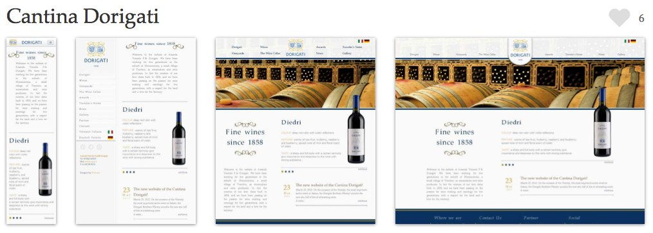

Slide 64


Slide 65


Slide 66


Slide 67


Slide 68


Slide 69


Slide 70


Slide 71


Slide 72


Slide 73


Slide 74


